Slide 1
An overview of 3 years of SPLADE
Carlos Lassance @ IR Glasgow 09/10/2023

Slide 2

Who am I?
Research Scientist at Naver Labs Europe (NLE)
Background:
Machine Learning (optimization, generalization, pruning…)
GSP (Graph Signal Processing, GNNs, graph-based geometry)
IR: Last 3 years
i.e. Ton of rookie mistakes
Works I’m presenting were only possible due to multiple collaborators:
Thibault Formal, Stéphane Clinchant, Simon Lupart, Hervé Dejean
Nicolas Tonellotto, Benjamin Piwowarski, Vaishali Pal, Arnaud Sors

Slide 3
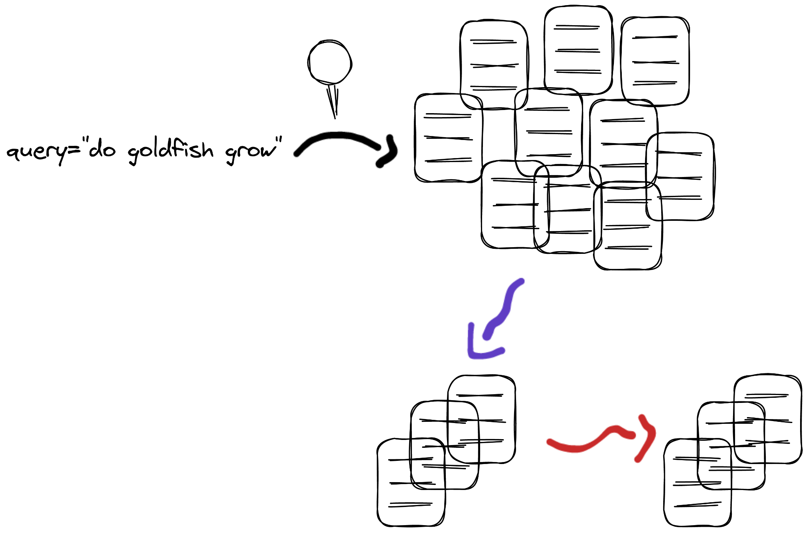
Context – Information Retrieval
large collection (e.g. 1B web pages)
re-ranking
high compute, precision oriented
ranked list of documents

Slide 4
Context – First stage retrieval
Traditional sparse
BM25, TF-IDF, DPH, Rocchio (PRF)…
Single-Vector Dense retrieval
DPR, Contriever, OpenAI Embeddings, Cohere Embeddings…
Learned Sparse Retrieval (LSR)
SPLADE, DeepImpact, SPADE, uniCOIL…
Multi-Vector retrieval
ColBERT, COIL, SparseEmbed…

Slide 5
Learned Sparse Retrieval (LSR)
Why: Effective and allow to keep current infrastructure
We can directly use them in ElasticSearch and others*
How: Neural models predict term weights
Term weights can then be stored using inverted indexes
Drawbacks:
* Terms and conditions apply: Efficiency is not free on these methods
If no learned term-expansion: Hard to maximize effectiveness
If learned term-expansion: Hard to balance efficiency-effectiveness
Adds even more hyperparameters

Slide 6
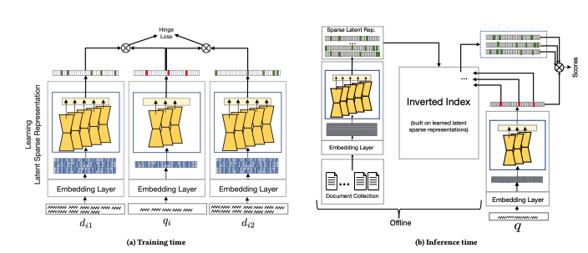
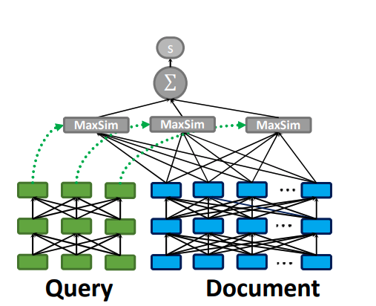
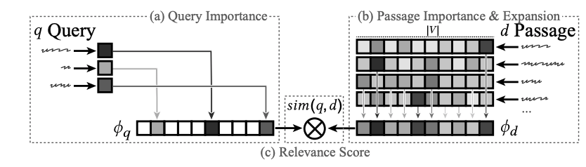
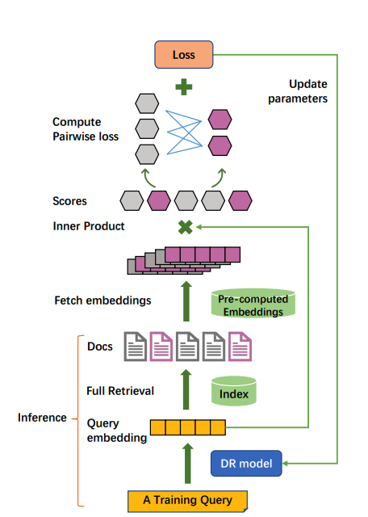
Context – How did we end up at SPLADE
SNRM, Hamed Zamani et al 2018
ColBERT, Omar Khattab et Zaharia 2020
EPIC, Sean Macavaney et al 2020
LTR, Jingtao Zhan et al 2020

Slide 7
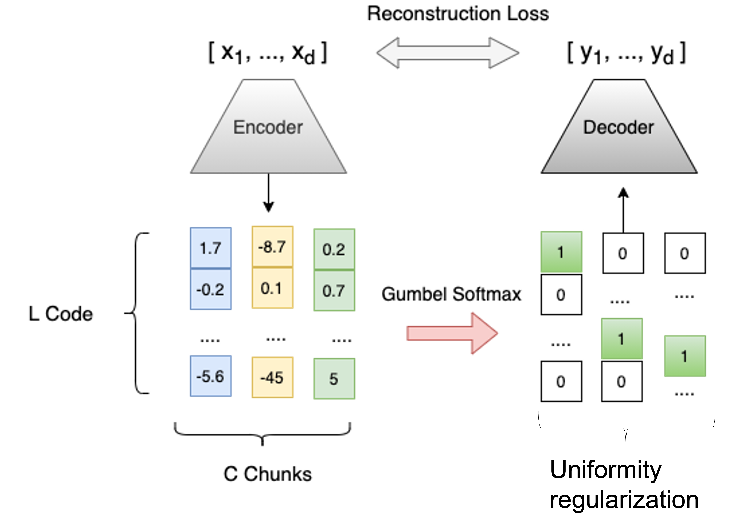
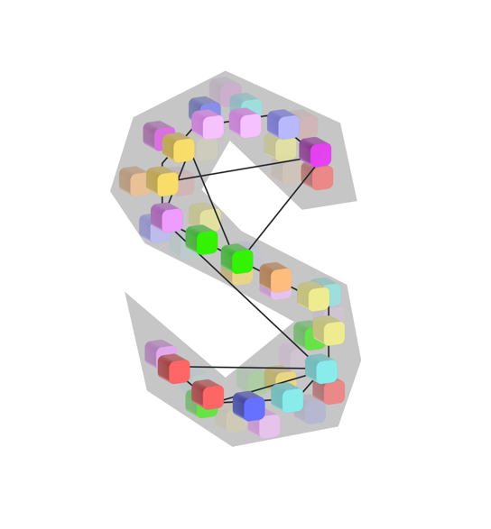
Context – How did we end up at SPLADE
CCSA, Carlos Lassance et al 2021
SPLADE, Thibault Formal et al 2021

Slide 8
Overview
Introduction
SPLADE
Training (SPLADE v1 + Pretraining from Scratch)
Effectiveness (SPLADE v2 / SPLADE ++)
Efficiency (Efficient SPLADE + Pruning LSR)
Applications
MultiLingual (or SPLADE outside of English)
MultiModal
Out of domain

Slide 9
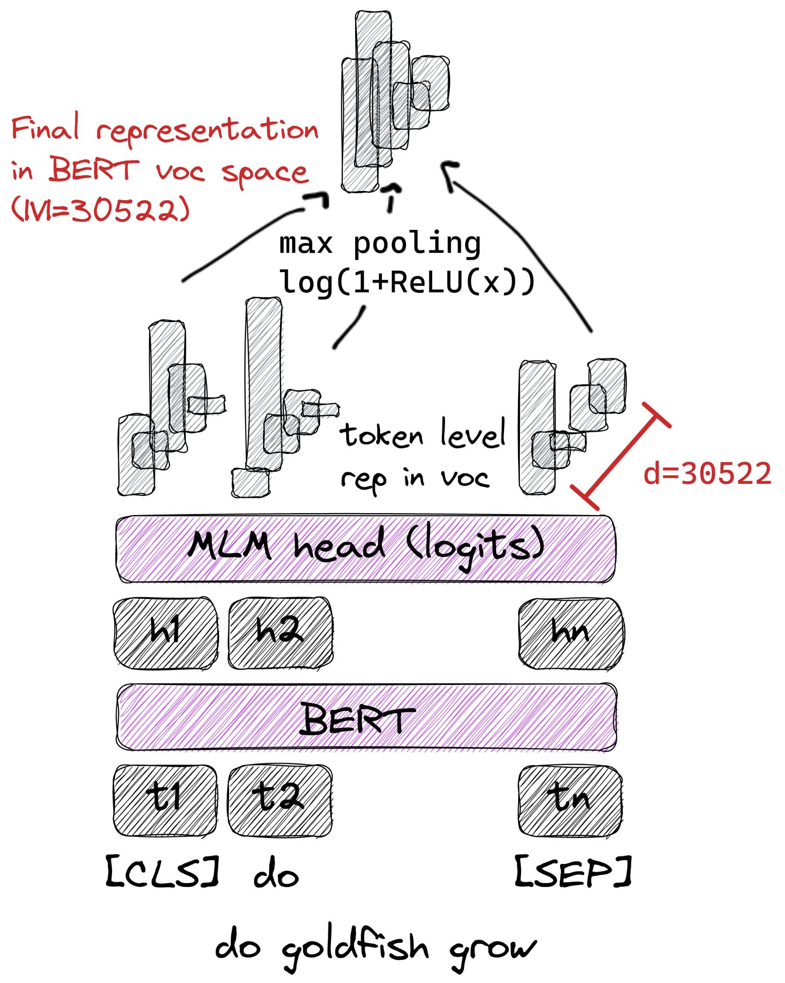
SPLADE – quick intro
Use the MLM output
Max pooling over each token output
Induce sparsity:
ReLU over the output
FLOPS [Paria et al 2020] regularization
Estimate number of activations in a batch
Proxy for total retrieval FLOPS
Saturation with log
Inspired by lexical models
Improved training
In hindsight…
http://github.com/naver/splade

Slide 10
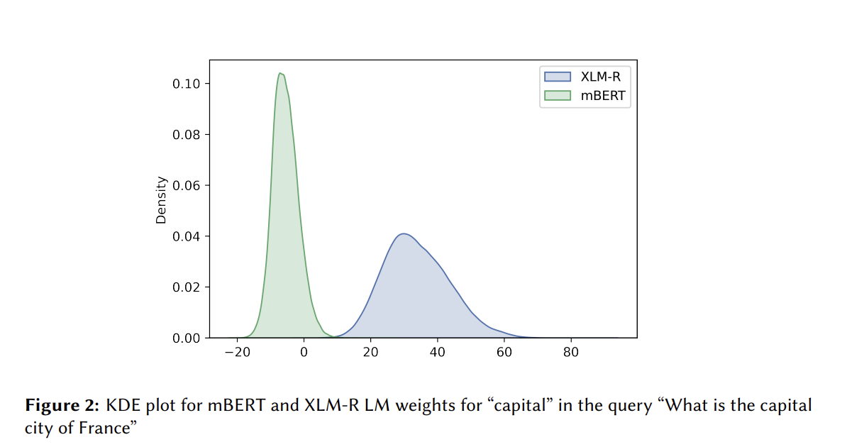
Log saturation hindsight
mBERT
Values 0 and 2.3
Most are zeroed
Easy to learn
XLM-Roberta
Values 2.3 and 4
Most [3,4]
Tons of noise
Image from: Nair et al 2022, SPLADE-x Learning a Sparse Representation Model for Neural CLIR @ DESIRES22

Slide 11
SPLADE – example
11

Slide 12
SPLADE – training
Double dynamic:
Retrieval loss
Contrastive with Triplets (Q,D+,D-)
Q closer to D+ than D-
Distillation from stronger method (Cross-Encoder reranker)
Sparsity loss
Reduce the total amount of FLOPS
Not actually linked to efficiency
Pre-training / Middle-training
Prepare the network for being used by SPLADE
Unsupervised MLM+FLOPS

Slide 13
SPLADE – why pretrain/middle-train
MLM learns document expansion
Not necessarily term weighting
Control parameters
Data
Tokenization
Language
Cost
BERT effectiveness
1 day with 2A100
Image from: Nair et al 2022, SPLADE-x Learning a Sparse Representation Model for Neural CLIR @ DESIRES22

Slide 14
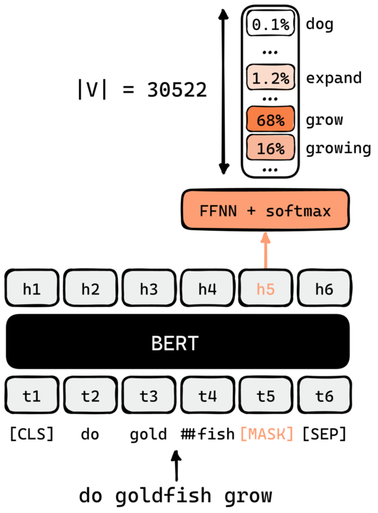
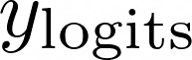
SPLADE – Relation to MLM training
Document expansion
No sparsity
Probability
Many solutions
Logits not bounded
SPLADE log saturation
Thanks T. Formal for the figure

Slide 15
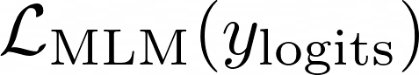
SPLADE – MLM+FLOPS training
MLM:
MLM+FLOPS:
Enforces saturation
Introduces sparsity
Balance terms
Bounds values
Avoids collapse
Sparse document expansion

Slide 16
Overview
Introduction
SPLADE
Training (SPLADE v1 + Pretraining from Scratch)
Effectiveness (SPLADE v2 / SPLADE ++)
Efficiency (Efficient SPLADE + Pruning LSR)
Applications
MultiLingual (or SPLADE outside of English)
MultiModal
Out of domain

Slide 17
SPLADE ++ - Context
Update SPLADE with advances of dense retrieval
Pretraining models
Co-condenser
Main advantage: MLM on in-domain collection
Distillation
MSE-loss
Main advantage:
Improve labelling
Easier to mimic than to create
Formal et al 2022: From Distillation to Hard Negative Sampling: Making Sparse Neural IR Models More Effective

Slide 18

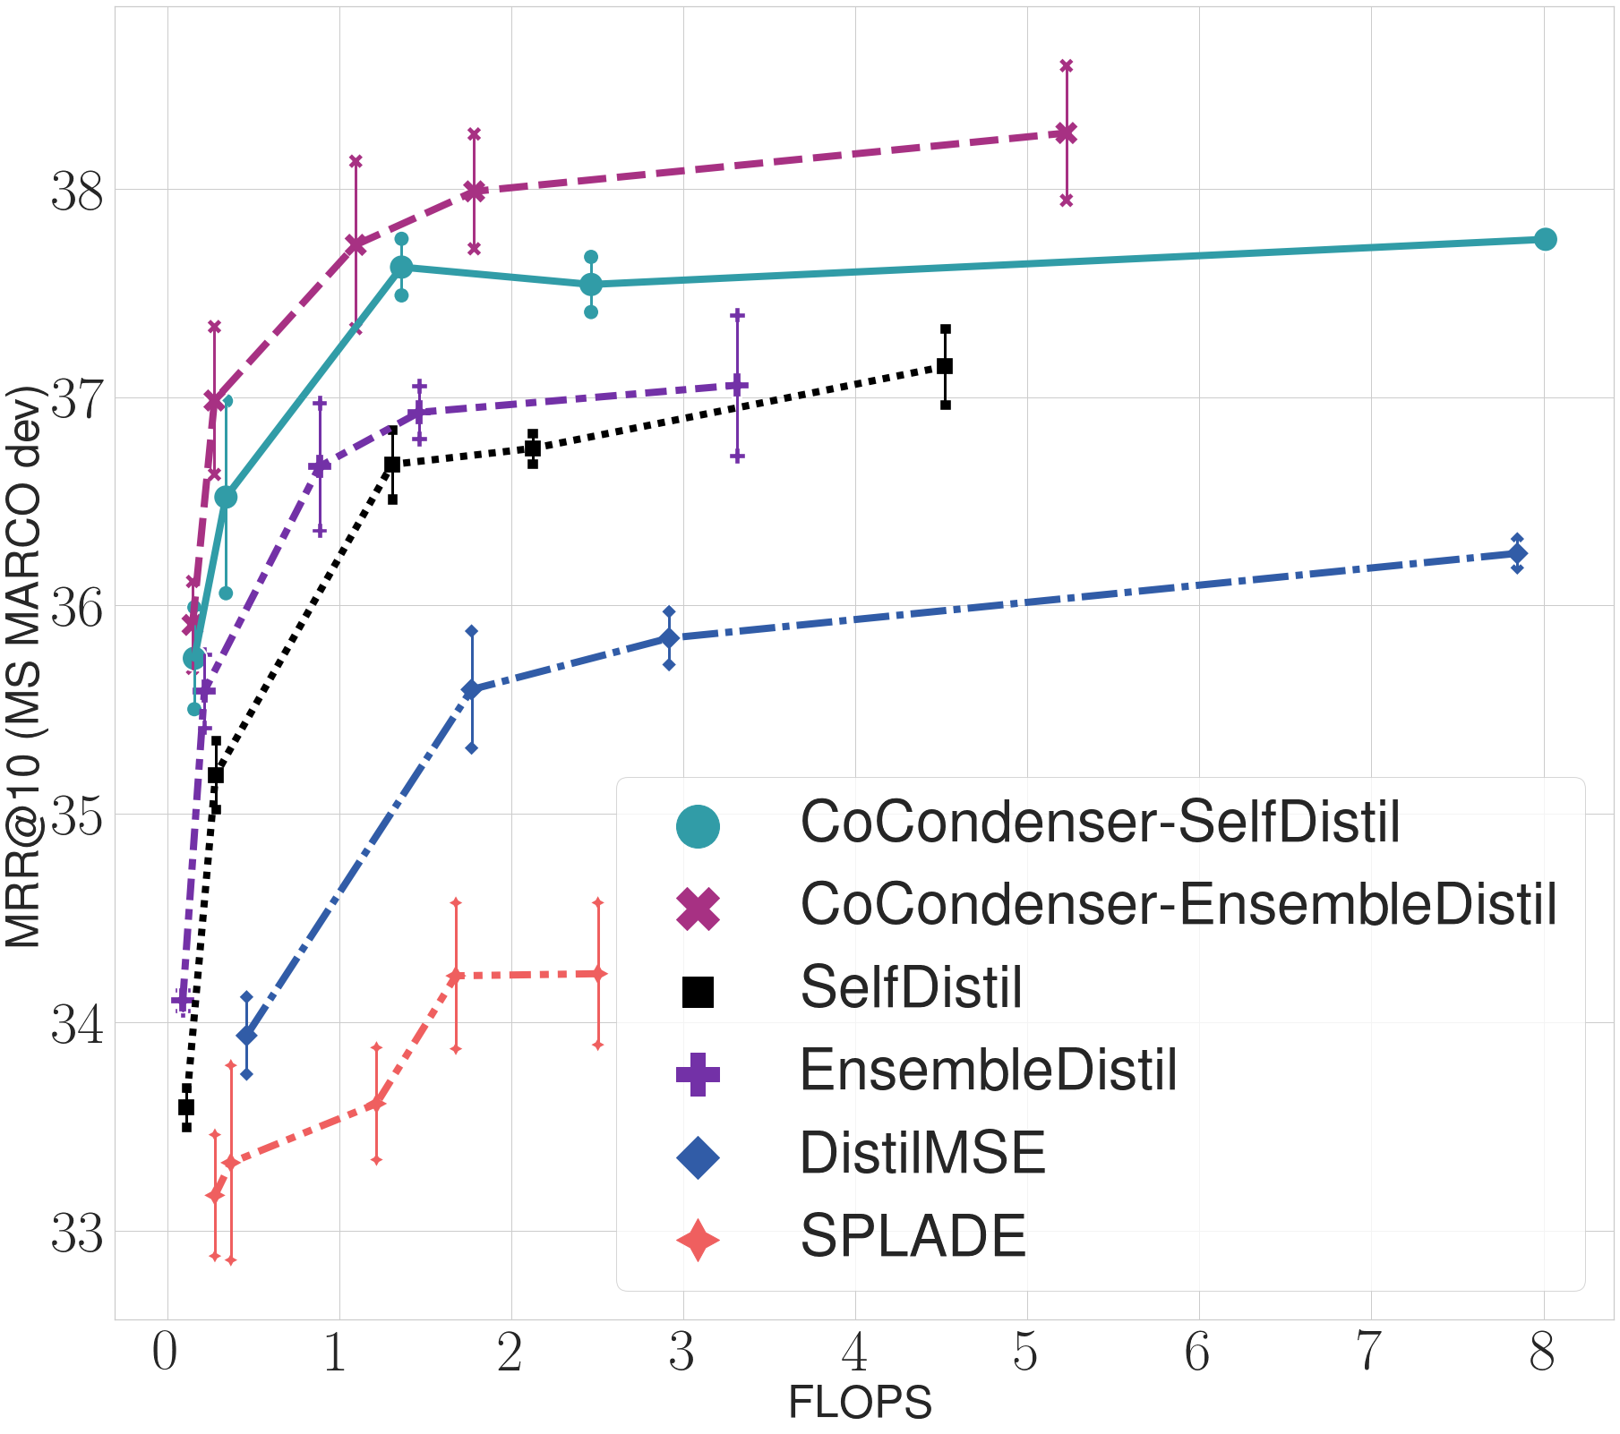
SPLADE++ - In-domain results
Formal et al 2022: From Distillation to Hard Negative Sampling: Making Sparse Neural IR Models More Effective

Slide 19
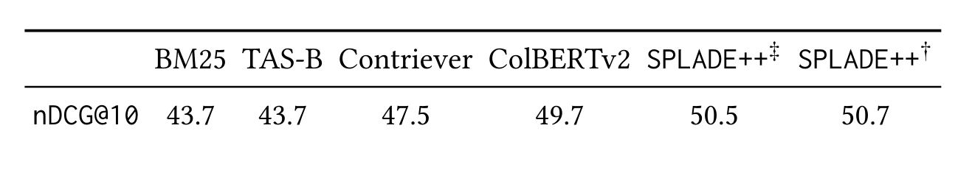
SPLADE++ - Zero-shot results (BEIR)
Dense models underperformed in out-of-domain
Being improved with better pre-training (see E5)*
* extra pretraining might make it not zero-shot
SPLADE was the solely
Formal et al 2022: From Distillation to Hard Negative Sampling: Making Sparse Neural IR Models More Effective

Slide 20
Effectiveness - Conclusion
SPLADE is an effective method
It shines in out-of-domain scenarios
Most advances in dense retrieval translate well to SPLADE
Note: these comparisons are a bit old (Jan 2022)
Needs updating
Should appear soon

Slide 21
Overview
Introduction
SPLADE
Training (SPLADE v1 + Pretraining from Scratch)
Effectiveness (SPLADE v2 / SPLADE ++)
Efficiency (Efficient SPLADE + Pruning LSR)
Applications
MultiLingual (or SPLADE outside of English)
MultiModal
Out of domain

Slide 22
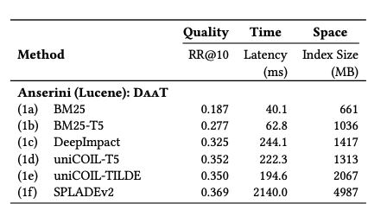
Efficiency – Current methods
Findings:
Recent sparse models are slower than BM25
SPLADE 50x slower on mono-thread evaluation
Wacky Weights, Mackenzie, Trotman and Lin, 2021

Slide 23
Efficiency – Current methods
Completely redesign training for efficiency
Efficient-SPLADE (following slides)
Approximate Sparse retrieval
Prune the index (following slides)
Sketching (Bruch et al)
Densifying Sparse (Lin and Lin)
Modify the inverted index algorithm
Guided Traversal (Mallia et al)
Postings Clippings (Mackenzie et al)

Slide 24
Efficient SPLADE – redesigning training
III) Separating encoders
Traditional SPLADE makes no difference between query and document
Hard for the model to learn that sparsities may be different
IV) Using L1 regularization instead of FLOPS on queries
FLOPS is optimized for generating balanced indexes
Queries need to be small, but don’t need to be balanced
V) Unsupervised FLOPS+MLM training
Improves the state of the network before pretraining
Network already knows output should be sparse
VI) Use smaller query encoder
Reduce query encoding time
An efficiency study for splade models, Lassance and Clinchant 2022

Slide 25
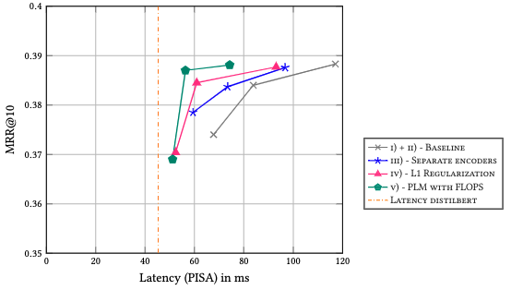
Efficient SPLADE – in-domain results
An efficiency study for splade models, Lassance and Clinchant 2022

Slide 26
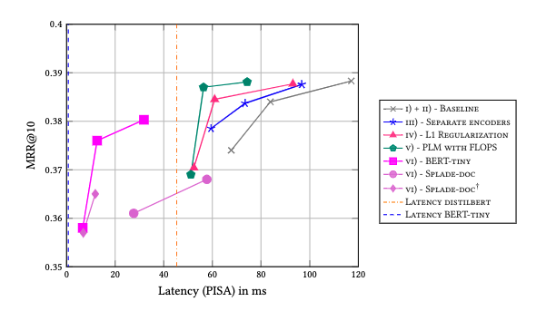
Efficient SPLADE – in-domain results
An efficiency study for splade models, Lassance and Clinchant 2022

Slide 27
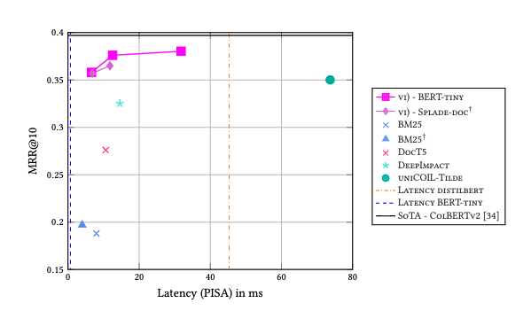
Efficient SPLADE – in-domain results
An efficiency study for splade models, Lassance and Clinchant 2022

Slide 28
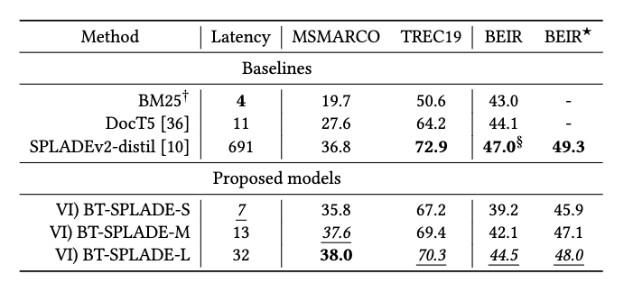
Efficient SPLADE – out-of-domain results
BEIR* creates an ensemble with BM25 to non BM25-baselines
Latency increases by 4 ms
An efficiency study for splade models, Lassance and Clinchant 2022

Slide 29
Pruning LSR methods - Intro
What can we do with a fixed model?
No retraining
Pruning can be the solution
Indexes have redundant info
Basic methods
Document-centric: Prune documents to k
Term-centric: Prune posting lists to a relative size
Agnostic: Remove scores lower than x
A Static Pruning Study on Sparse Neural Retrievers, Lassance et al 2023

Slide 30
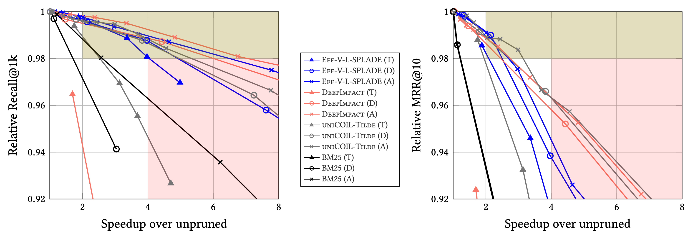
Pruning LSR methods – In domain results
Recall is less sensitive than MRR
2x -> 2%, 4x -> 8%
A Static Pruning Study on Sparse Neural Retrievers, Lassance et al 2023

Slide 31
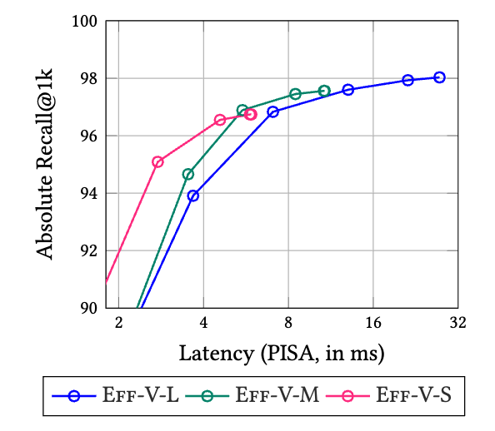
Pruning LSR methods – Prune or FLOPS?
A Static Pruning Study on Sparse Neural Retrievers, Lassance et al 2023

Slide 32
Efficiency - Conclusion
SPLADE can be made efficient
With retraining (Efficient-VI-BT-Medium):
Only 2x the cost of BM25 on MSMARCO
Comparable to ColBERTv2 on MSMARCO (<10%)
Comparable to SPLADEv2 on BEIR when combined with BM25 (<5%)
Out-of-domain effectiveness suffers a lot
Without retraining (Pruning)
2x speed-up with 2% loss or 4x with 8% loss
Can be combined with FLOPS training
Allows for approximate retrieval

Slide 33
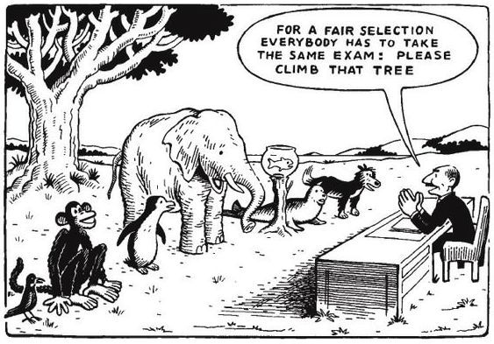
Comparison with dense models Efficiency
OPEN QUESTION
Take results with a grain of salt
Not exactly sure how to do it fairly
Different software makes for different benchmark
Comparing PISA/Anserini/JASS vs NMSlib/FAISS ?
Different optimizations
Approximate KNN (Dense) vs KNN (Sparse)
“Uniform” Latency (Dense) vs “Variable” Latency (Sparse)
Mono-cpu (Latency) vs Multi-cpu/gpu (QPS)
Keep index small (IVF, PISA) vs Precompute and store everything (HNSW)
Notes:
Finally, we also compare on out-of-domain data.
OOD data is one of the largest advantages of SPLADE and we were quite surprised that the effective models lose a lot of performance (from 47 to 44/42 or even 39)
However, using an ensemble of BEIR and SPLADE can recover most of the lost performance, always outperforming both BM25 and DocT5 and even sometimes SPLADEv2

Slide 34
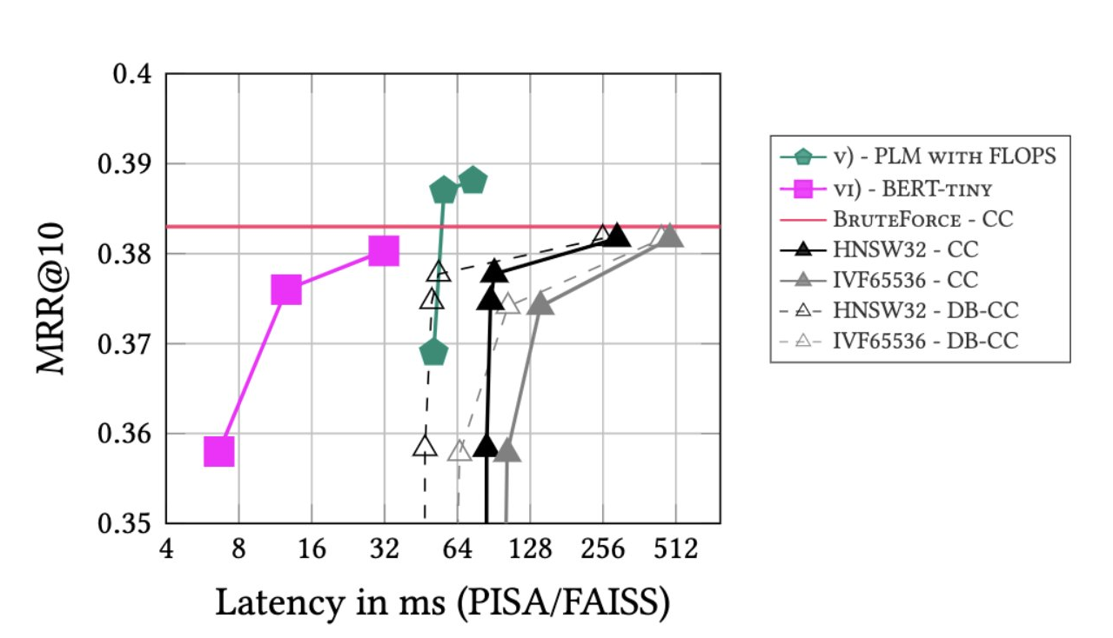
Comparison with dense models Latency
OPEN QUESTION
Take results with a
grain of salt
Notes:
Finally, we also compare on out-of-domain data.
OOD data is one of the largest advantages of SPLADE and we were quite surprised that the effective models lose a lot of performance (from 47 to 44/42 or even 39)
However, using an ensemble of BEIR and SPLADE can recover most of the lost performance, always outperforming both BM25 and DocT5 and even sometimes SPLADEv2

Slide 35
Overview
Introduction
SPLADE
Training (SPLADE v1 + Pretraining from Scratch)
Effectiveness (SPLADE v2 / SPLADE ++)
Efficiency (Efficient SPLADE + Pruning LSR)
Applications
MultiLingual (or SPLADE outside of English)
MultiModal
Out of domain

Slide 36
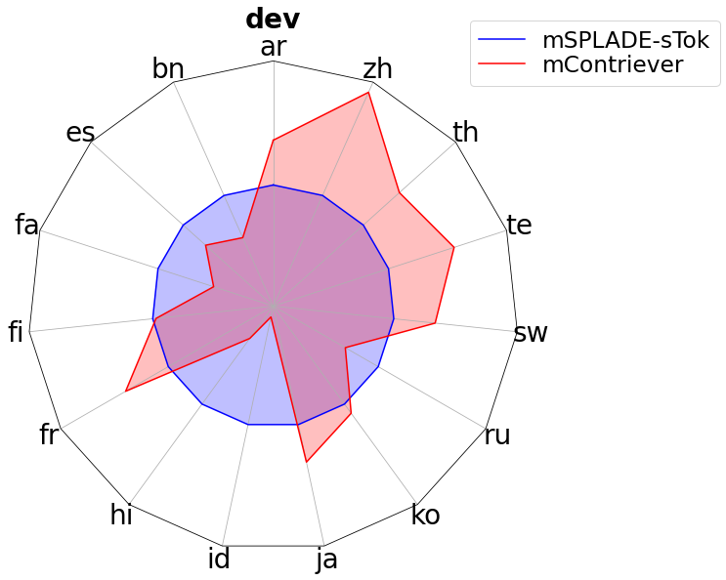
Multilingual SPLADE
Winner at WSDM CUP 23 - MIRACL🌍🙌🌏
Shown to work well at
TREC-NeuCLIR
Mr.TyDi
Over 18 languages
Monolingual
Multilingual
Hard to train
Depend on the initial model
MLM+FLOPS helps

Slide 37
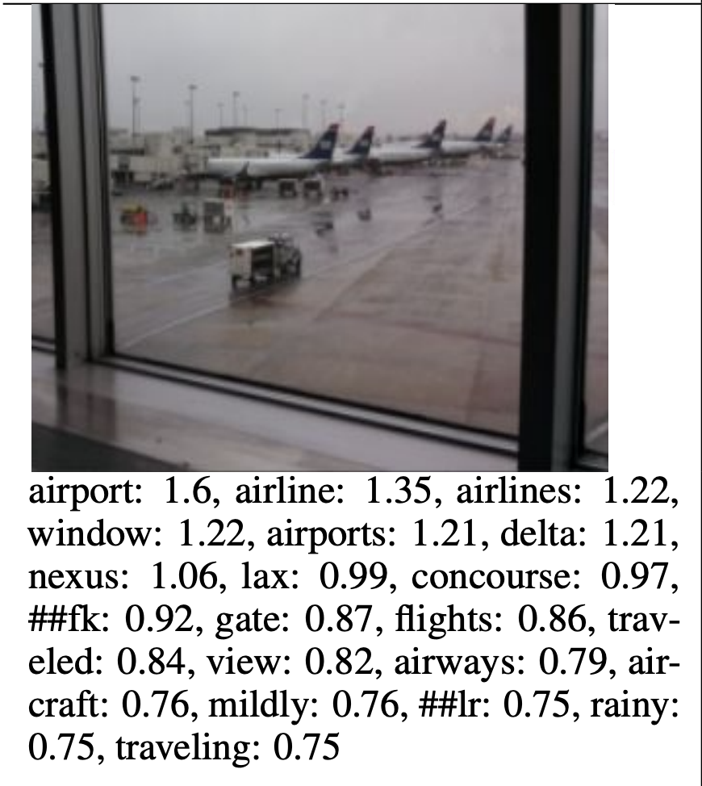
MultiModal SPLADE
Two implementations
STAIR – Chen et al 2023 -> APPLE
Huge proprietary dataset
Trained with contrastive loss
Improves over CLIP on zero-shot
LexLIP – Luo et al 2023 -> Microsoft
Adds various loss to control pretraining
Trained solely with public data
Outperforms previous retrieval SoTA

Slide 38
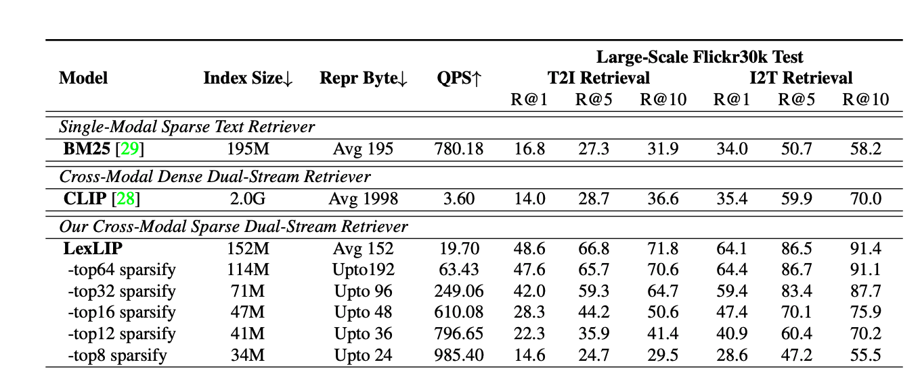
MultiModal SPLADE - LexLIP
Example of why I’m afraid of comparing to dense
Comparing to brute force does not make sense
Makes dense seem a lot slower than in reality

Slide 39
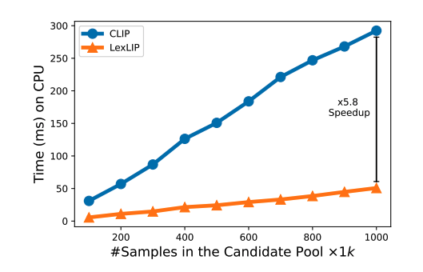
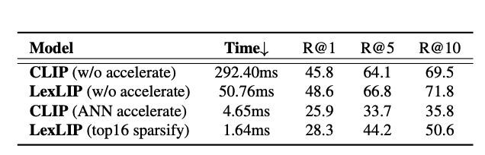
MultiModal SPLADE - LexLIP
Actually got fixed last week (Accepted at ICCV)
And maybe will release code? Github promissed for next week
More coherent, still weird IMO
Smaller than MSMARCO, slower dense

Slide 40
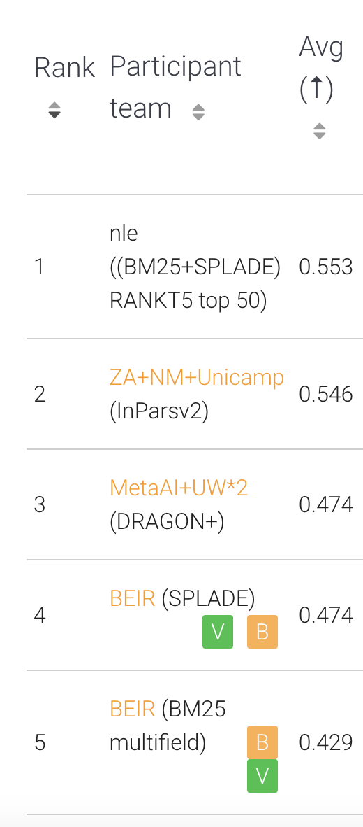
Out-of-domain
Currently at the top of the BEIR leaderboard
Leaderboard has not had that much success…
Requires data hard to get
Why not MTEB
Not zero-shot (includes MSMARCO)
Focuses on dense embeddings (evaluation of other tasks)
People are starting to overfit to it (first places train at a variety of datasets)
https://eval.ai/web/challenges/challenge-page/1897/leaderboard/4475

Slide 41
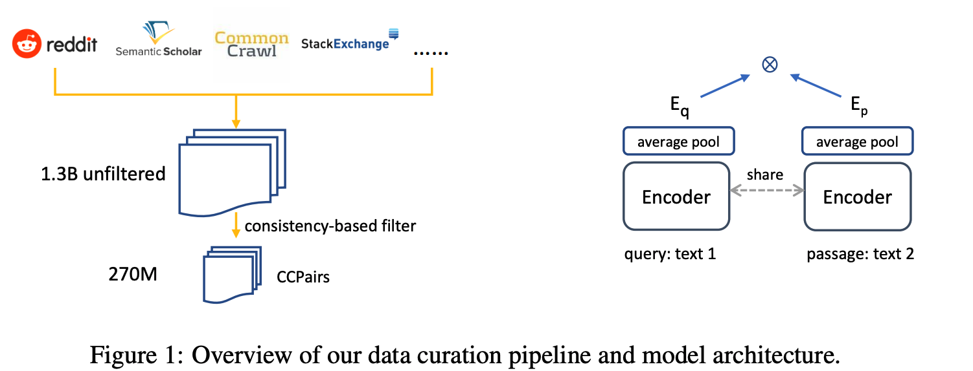
Why not MTEB – E5 3rd place of leaderboard

Slide 42
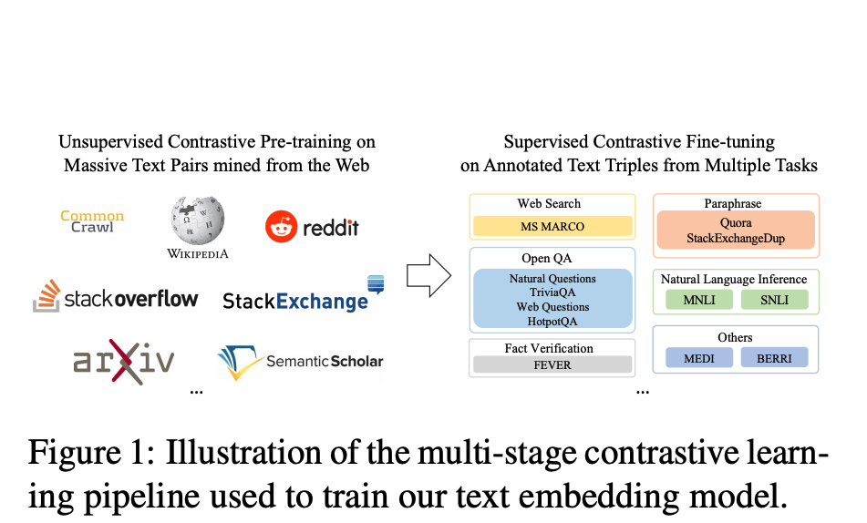
Why not MTEB - GTE 2nd place of leaderboard

Slide 43
Conclusion and next steps
SPLADE is mature after 3 years of research
300k downloads last month, 3M in total for SPLADE++ PPED (huggingface)
Able to get latency near BM25 (even zero-shot OOD, under submission)
One of the best models for zero-shot OOD
Pain-points:
We still use tokens and not full words
Stemming effects are lost, huge concentration, ambiguity
Indexing is much more costly than BM25
Training is better, but still too many hyperparameters
Impossible to guarantee effectiveness OOD

Slide 44
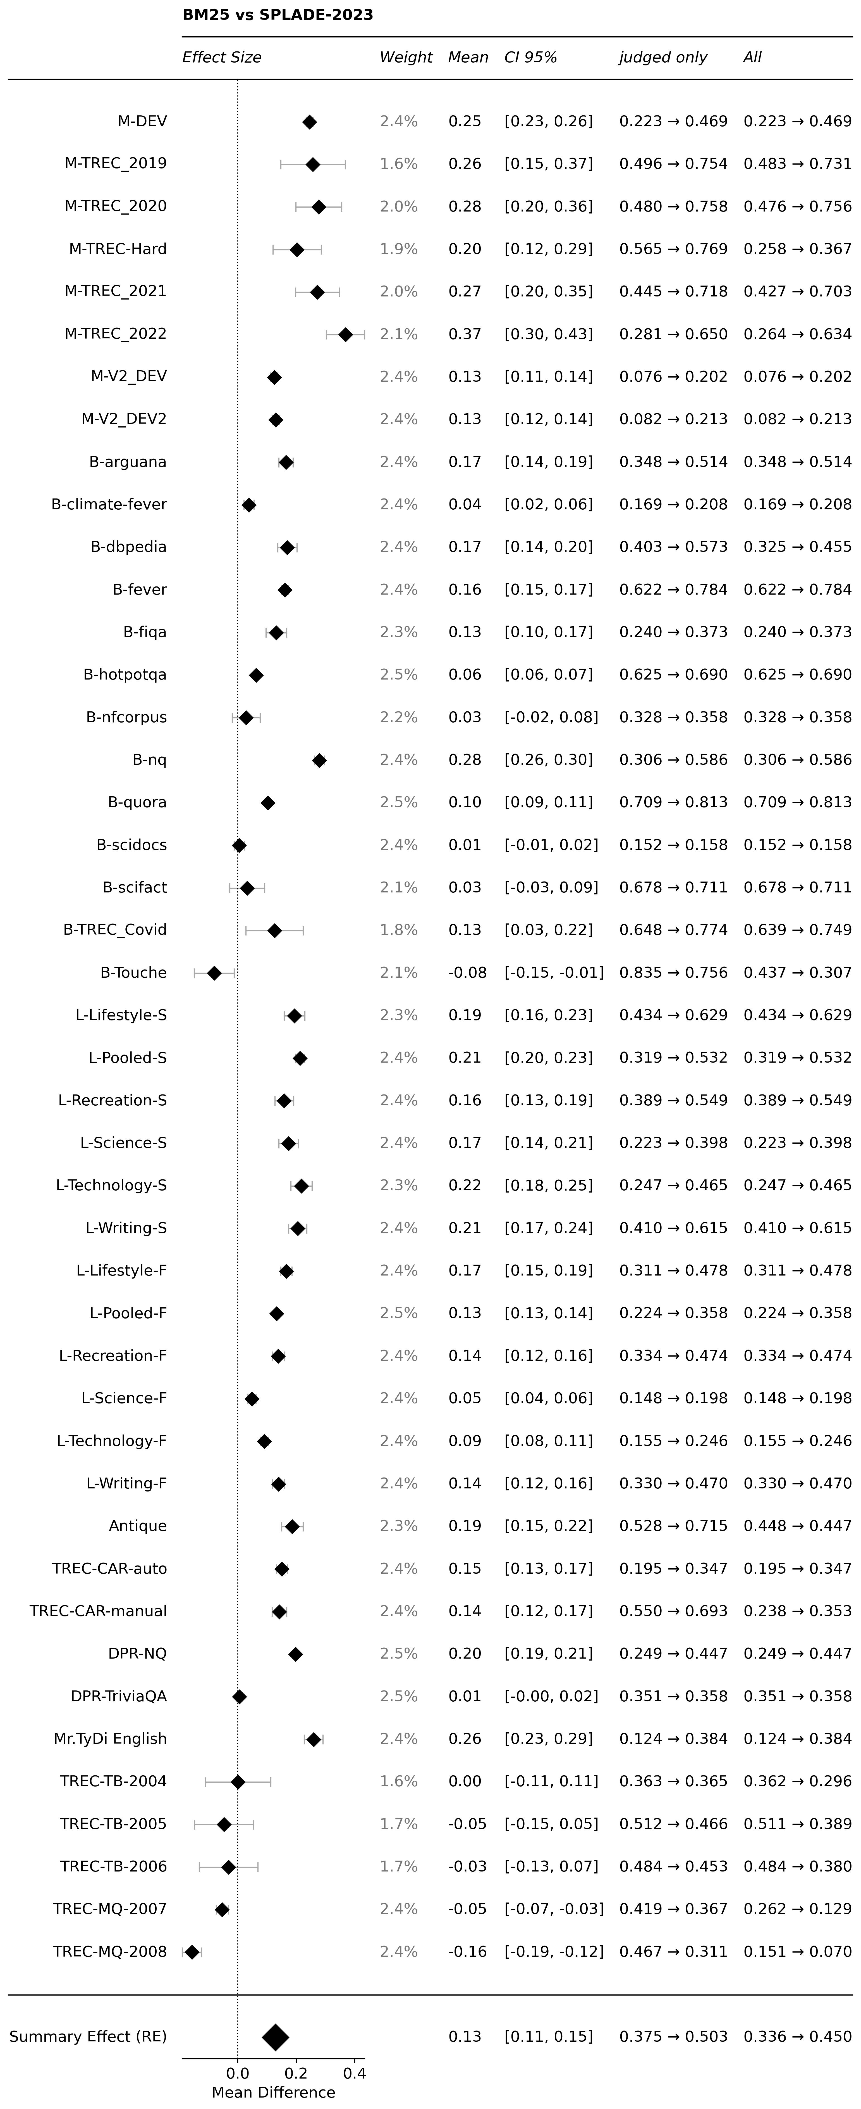
Thanks to ir_datasets and ranger

Slide 45
Thanks a lot for your attention

